Slide 1
Internal components of computer
By Ali Aiman and Lukman

Slide 2
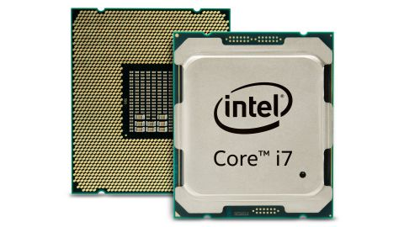
CPU (Central Processing Unit)
CPU processor as it is sometimes called, is the main chip in the computer and is located on the Motherboard.
The CPU processes the computer’s data and exchanges it with the other components and peripherals.
CPU’s come in different speeds, the most of common of which are between 500MHz - 800MHz. The speeds are measured in Mega Hertz (MHz) and even Giga Hertz (GHz).
The CPU is often referred to as the brain of the computer.

Slide 3


Slide 4
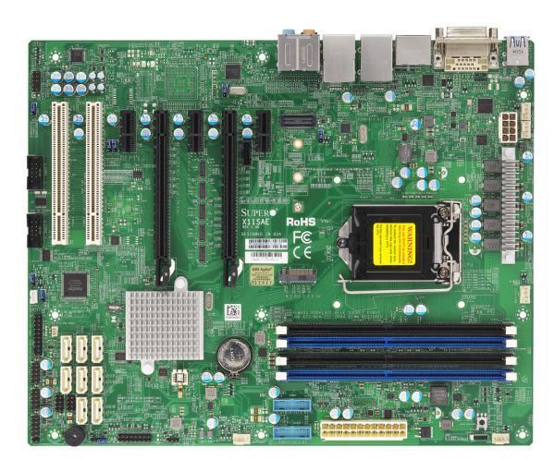
Motherboard
The Motherboard, or logic board as it is known in Macintosh computers, is the main circuit board in the computer.
The Motherboard contains many components like the RAM, CPU
expansion slots and the heat sink.
The motherboard connects all these peripherals together.

Slide 5


Slide 7
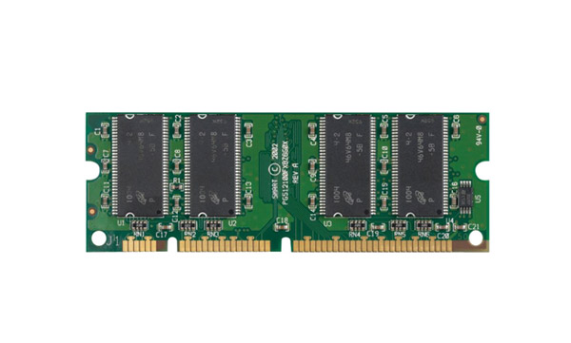
RAM(Random Accessing Memory)
the main memory that stores data on the computer.
RAM is a type of volatile memory which means it requires electricity to store data, so when the computer is powered downfall the memory is wiped.
There are many types of RAM including SRAM (Static Random Accessing Memory), DRAM (Dynamic Random Accessing Memory) and SO-DIMM RAM.
All these do similar jobs to the RAM.

Slide 8


Slide 9
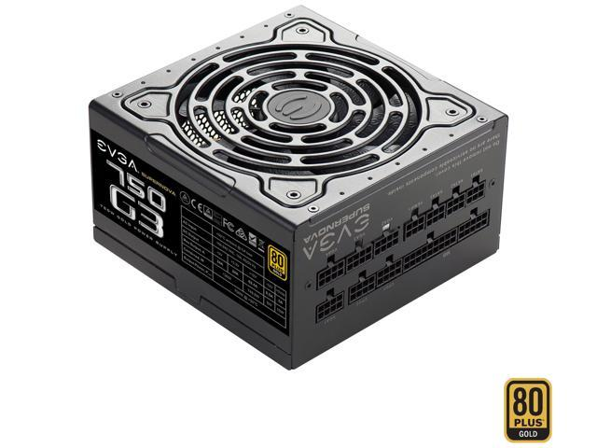
POWER SUPPLY
The Power Supply Unit supplies all the computer components which power (electricity).
The Power Supply Unit changes AC(Alternating Current) from the mains supply into DC ( Direct Current) which is used by the components.

Slide 10


Slide 11
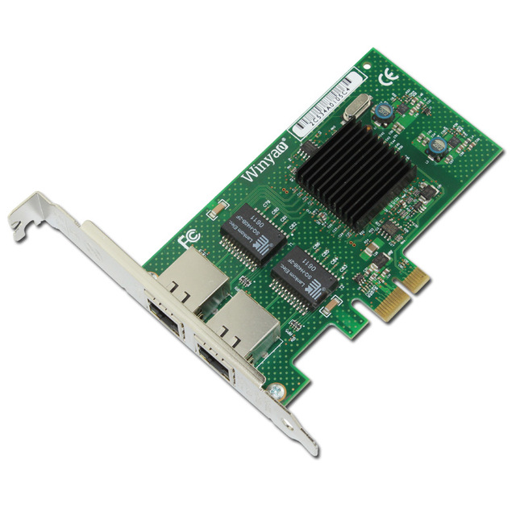
NIC CARD
Network Interface Card, is an adapter card that allows the computer to connect to a network.
The Wireless Network Interface Card allows the computer to access the network wirelessly. It uses radio signals to do so.

Slide 12


Slide 13
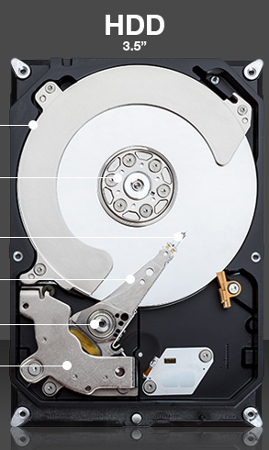
HDD (Hard disk Drive)
Is a drive that can read and write one magnetically coated platter, that spins at a high speed.
There can be more than one patter (disk) in the hard drive.
While the platter is rotating the magnetic head reads the data stored on it.
A computer can have more than one hard drive. In these circumstances the main hard drive is called the ‘master’ while the others are called ‘slaves’ these can be alternated by the a switch know as a ‘jumper’.

Slide 14


Slide 15
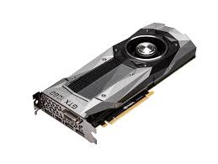
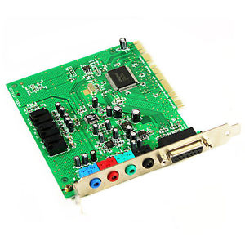
ADAPTER CARD
the motherboard there are a couple of expansion slots.
In these expansion slots go several printed circuit boards, or adapter cards as they are more commonly known.
The sound card is an adapter card that allows the computer to have extended sound capabilities, and for sound components to be used, for example, headphones.
The Video or Graphics card is an adapter card that allows the computer to show graphics on the monitor.

Slide 16


Slide 17
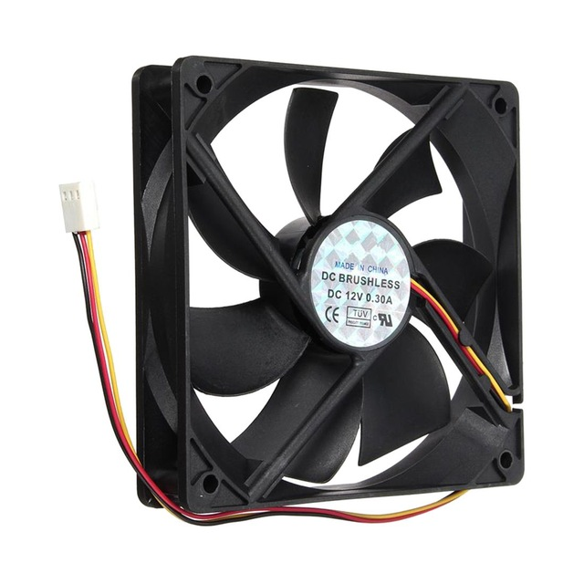
FAN
One of the main problems with computers, especially laptops, are that they can overheat easily. To stop this problem fans are added to cool the computer down.
The main fan is positioned on the CPU because the CPU is prone to overheating.
Firstly a thermal compound is put on top of the CPU followed by the heat sink, and the fan is placed on top of this.

Slide 18


